Slide 1
Decision Making & Basic Programs
Md. Alamgir Hossain
Senior Lecturer,
Dept. of CSE, Prime University
Mail: alamgir.cse14.just@gmail.com

Slide 2

Decision Making
There come situations in real life when we need to make some decisions and based on these decisions, we decide what should we do next.
Similar situations arise in programming also where we need to make some decisions and based on these decisions we will execute the next block of code.

Slide 3
Decision Making
Decision making statements in programming languages decide the direction of flow of program execution. Decision making statements available in C or C++ are:
if statement
if..else statements
nested if statements
if-else-if ladder
switch statements
Jump Statements:
break
continue
goto
return

Slide 4
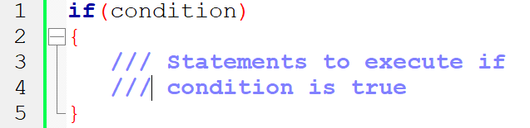
If statement in C
if statement is the most simple decision making statement.
It is used to decide whether a certain statement or block of statements will be executed or not i.e if a certain condition is true then a block of statement is executed otherwise not.
Syntax:

Slide 5
Logic for checking whether a number is 5 or not
Input a number from user in some variable say number.
Check if(number == 5), then number is 5.
Check if(number != 5), then number is not 5.

Slide 6
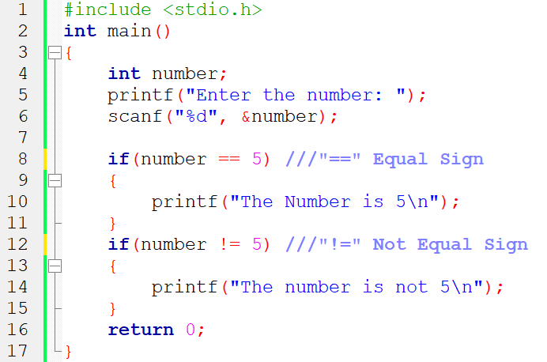
C program to check whether a number is positive, negative or zero

Slide 7
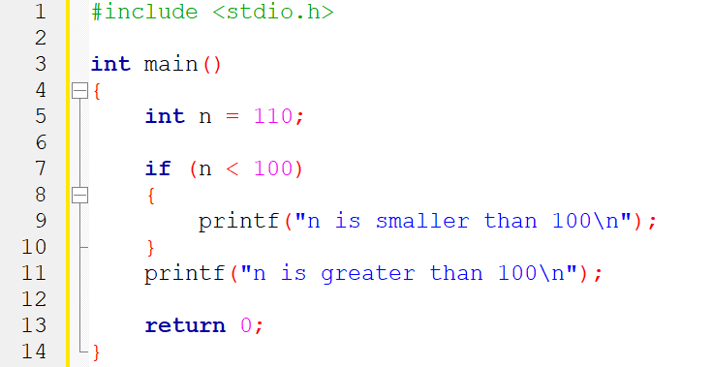
Simple program for if condition in C

Slide 8
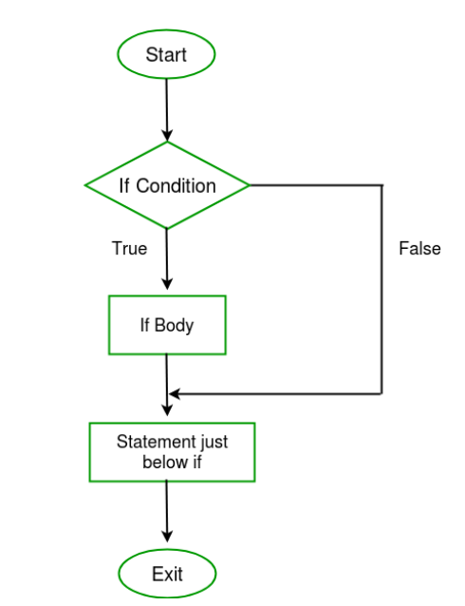
Flow chart of if condition

Slide 9
Logic for checking whether a number is positive, negative or zero
A number is said negative if it is less than 0 i.e. number < 0.
A number is said positive if it is greater than 0 i.e. number > 0.
We will use the above logic inside if to check number for negative, positive or zero. Step by step descriptive logic to check negative, positive or zero.
Input a number from user in some variable say num.
Check if(number < 0), then number is negative.
Check if(number > 0), then number is positive.
Check if(number == 0), then number is zero.

Slide 10
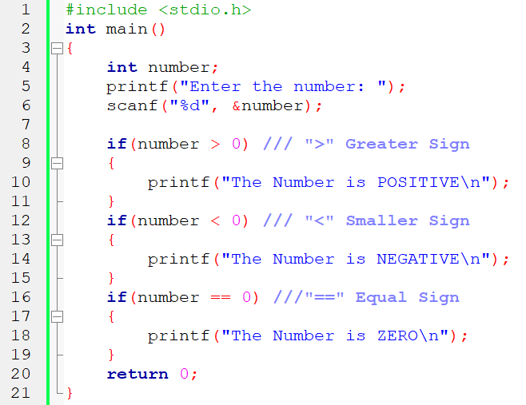
C program to check whether a number is positive, negative or zero

Slide 11
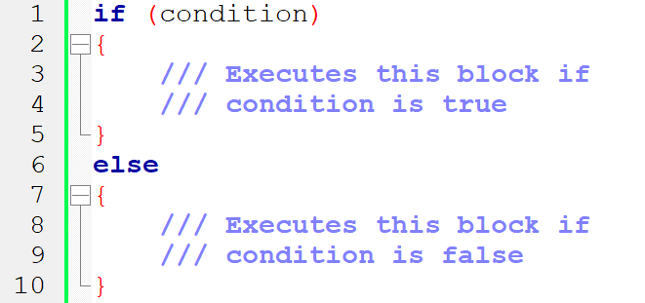
If-else statement in C
The if statement alone tells us that if a condition is true it will execute a block of statements and if the condition is false it won’t.
But what if we want to do something else if the condition is false. Here comes the C else statement. We can use the else statement with if statement to execute a block of code when the condition is false.
Syntax:

Slide 12
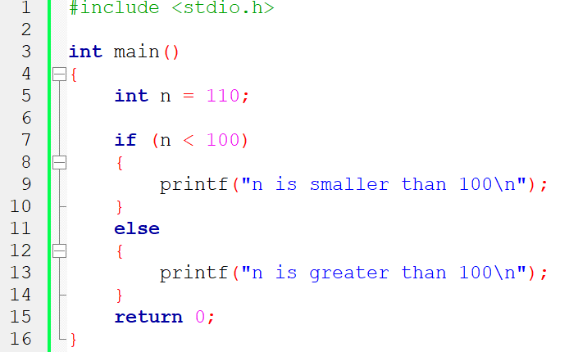
Program for simple If-else statement in C

Slide 13
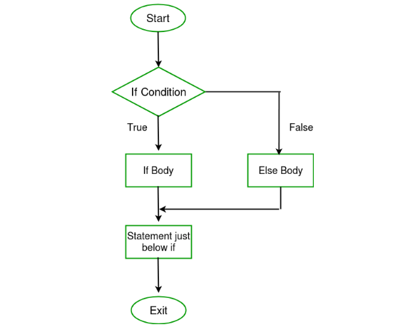
Flow-Chart of If-else statement

Slide 14
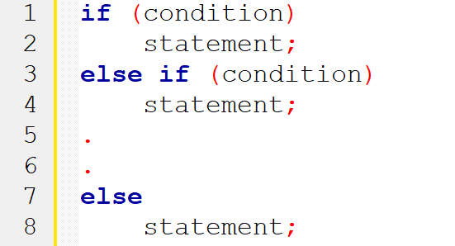
If-else-if ladder statement in C
Here, a user can decide among multiple options
Syntax:

Slide 15
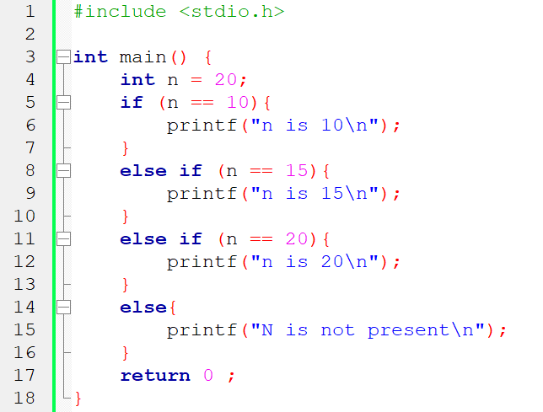
Program for simple If-else-if statement in C

Slide 16
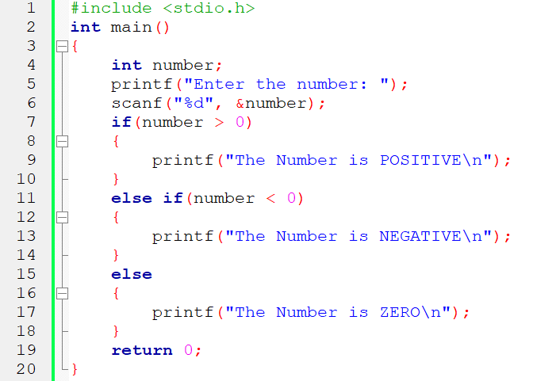
C program to check whether a number is positive, negative or zero

Slide 17
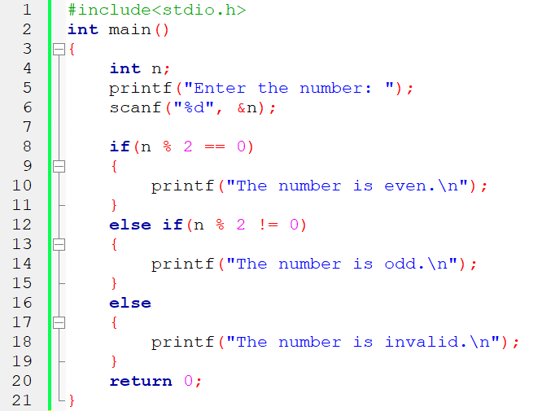
C program to check a number is even/odd

Slide 18
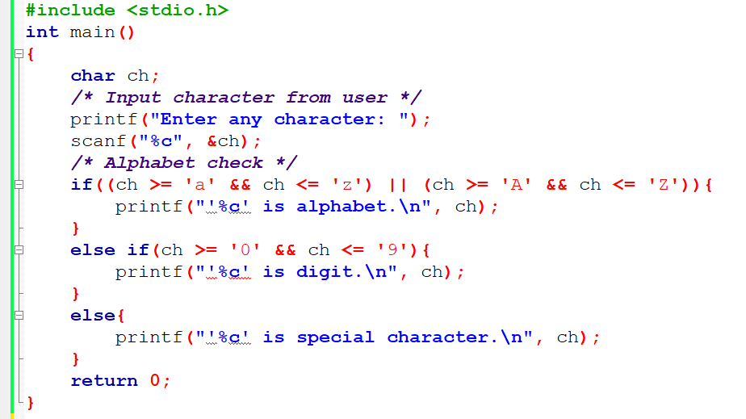
Program to check alphabet, digit or special character

Slide 19
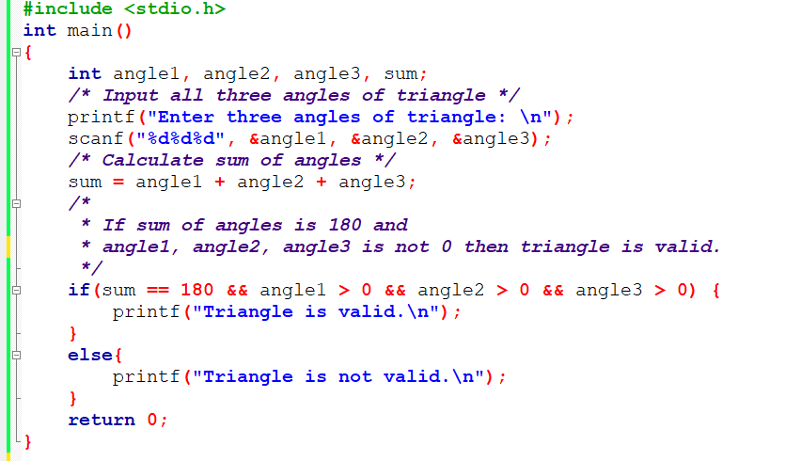
C program to check whether triangle is valid or not if angles are given

Slide 20
Write a C program to check whether triangle is valid or not if sides are given.

Slide 21
Nested-if in C/C++
Nested if statements means an if statement inside another if statement.
Yes, both C and C++ allows us to nested if statements within if statements, i.e, we can place an if statement inside another if statement.
Syntax:
if (condition1)
{
// Executes when condition1 is true
if (condition2)
{
// Executes when condition2 is true
}
}

Slide 22
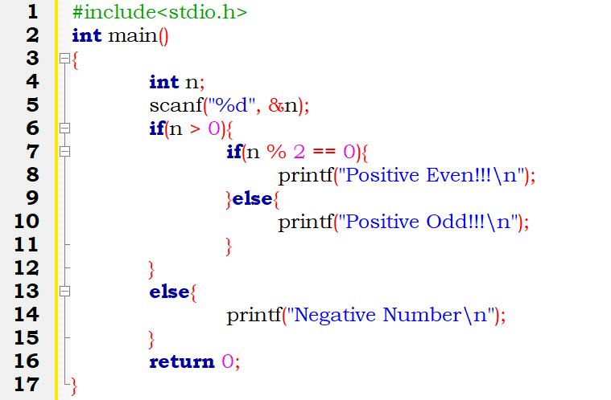
Example of nested-if in C/C++

Slide 23
Homework
Write a C program to check whether a number is divisible by 7 and 12 or not.
Write a C program to check whether a character is uppercase or lowercase alphabet.
Write a C program to count total number of notes in given amount.
Input: 1575
Output:
Total number of notes:
1000: 1, 500: 1, 100: 0, 50: 1, 20: 1, 10: 0, 5: 1, 2: 0, 1: 0

Slide 24
Practice Programs
Write a C program to input marks of five subjects C, Chemistry, CPP, JAVA and Python. Calculate percentage and grade according to following:
Percentage >= 90% : Grade A
Percentage >= 80% : Grade B
Percentage >= 70% : Grade C
Percentage >= 60% : Grade D
Percentage >= 40% : Grade E
Percentage < 40% : Grade F

Slide 25
Practice Programs
Write a C program to input basic salary of an employee and calculate its Gross salary according to following:
Basic Salary <= 10000 : HRA = 20%, MA = 10%
Basic Salary <= 20000 : HRA = 25%, MA = 20%
Basic Salary > 20000 : HRA = 30%, MA = 25%
*House Rent Allowance (HRA)
*Medical Allowance (MA)

Slide 26
Practice Programs
Write a C program to input electricity unit charges and calculate total electricity bill according to the given condition:
For first 50 units Tk. 0.50/unit
For next 100 units Tk. 0.75/unit
For next 100 units Tk. 1.20/unit
For unit above 250 Tk. 1.50/unit
An additional surcharge of 20% is added to the bill

Slide 27
Thank You

